Slide 1


License Plate Detection Using YOLOv8
Presented by :Hanzala haroon & Qamar ul hasnain
Roll number :F2022266697 & F2022266687
University : UMT
Your Supervisor: Dr. Syed Farooq Ali

Slide 2
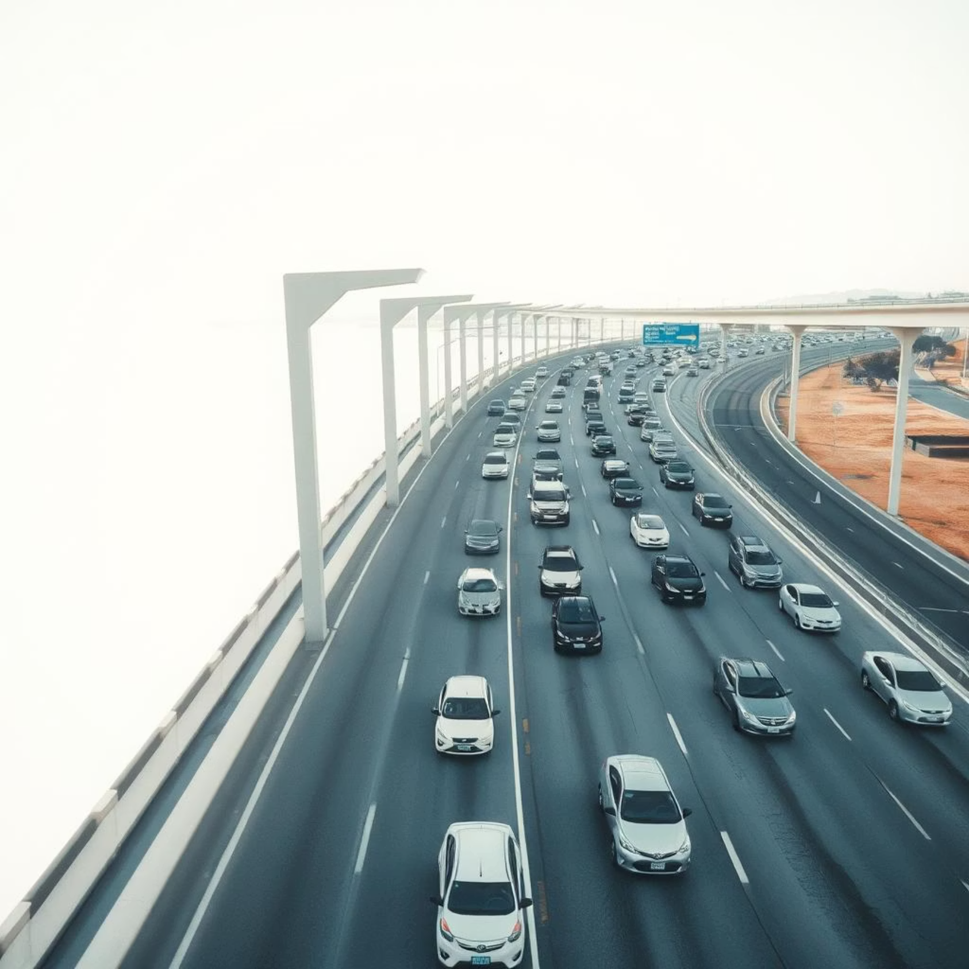
Introduction: The Challenge of Automated Recognition
Problem Statement
Automated and real-time license plate identification.
Motivation
Enhance traffic control, improve surveillance, and automate access systems.
Project Objectives
Develop a robust YOLOv8 model for accurate license plate detection.

Slide 3

Dataset Overview: Sourced from Roboflow
Our dataset, specifically curated for license plate detection, was sourced from Roboflow, a platform providing high-quality annotated computer vision datasets.
Dataset Source
Roboflow
Image Count
Split into training, validation, and test sets for comprehensive evaluation.
Labels
Each image is precisely labeled as "LicensePlate."

Slide 4
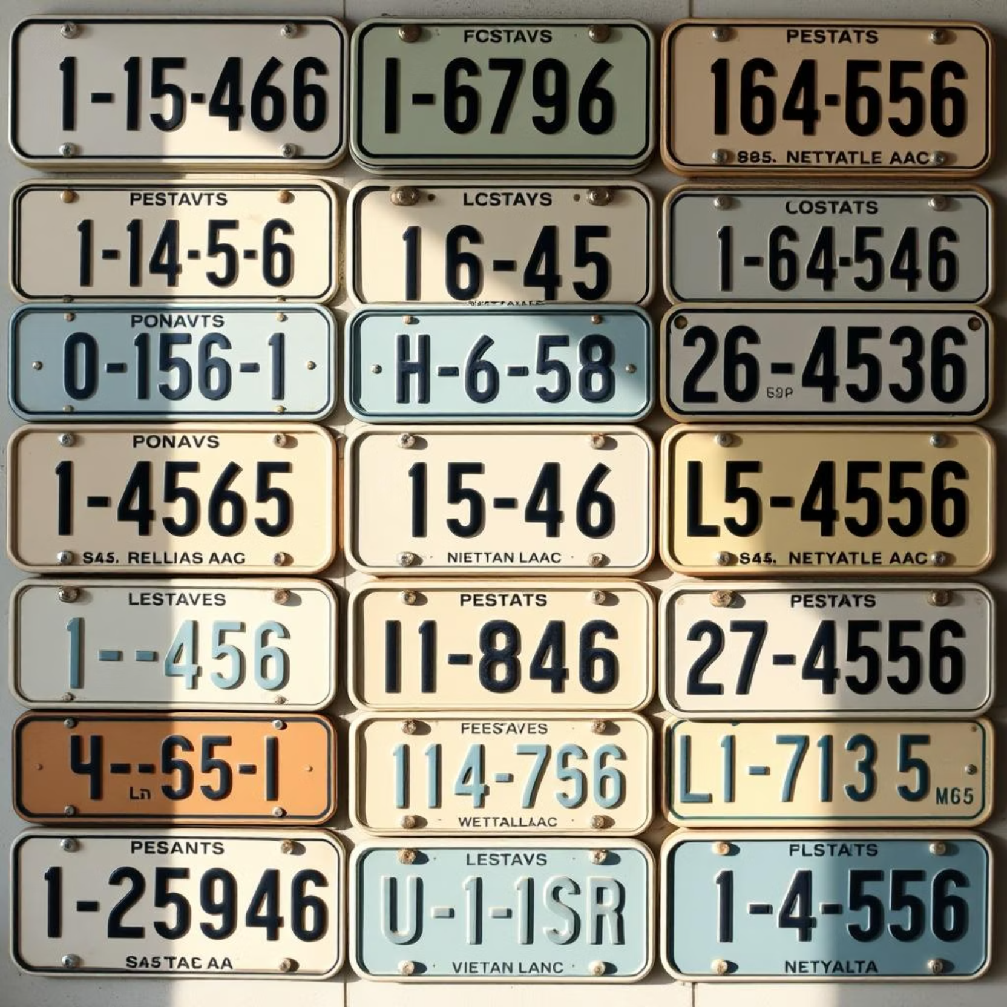
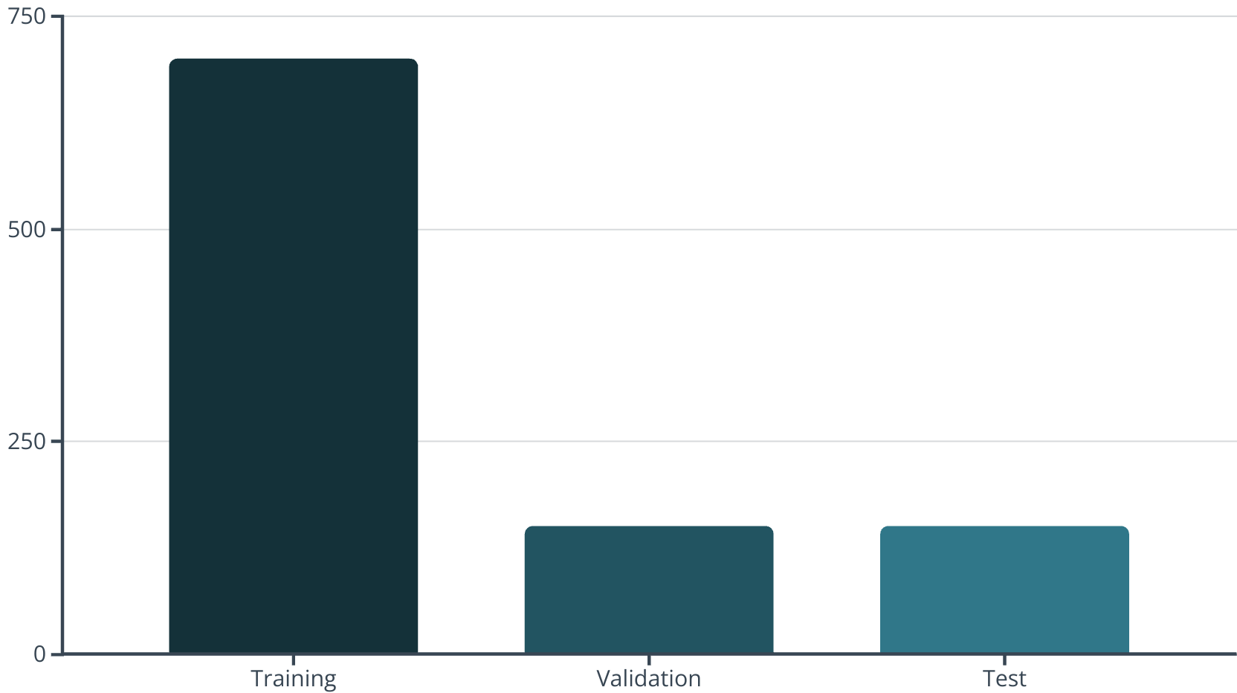
Dataset Visualization & Augmentation
Data augmentation techniques, such as rotation and brightness adjustments, were applied to enhance model robustness.

Slide 5
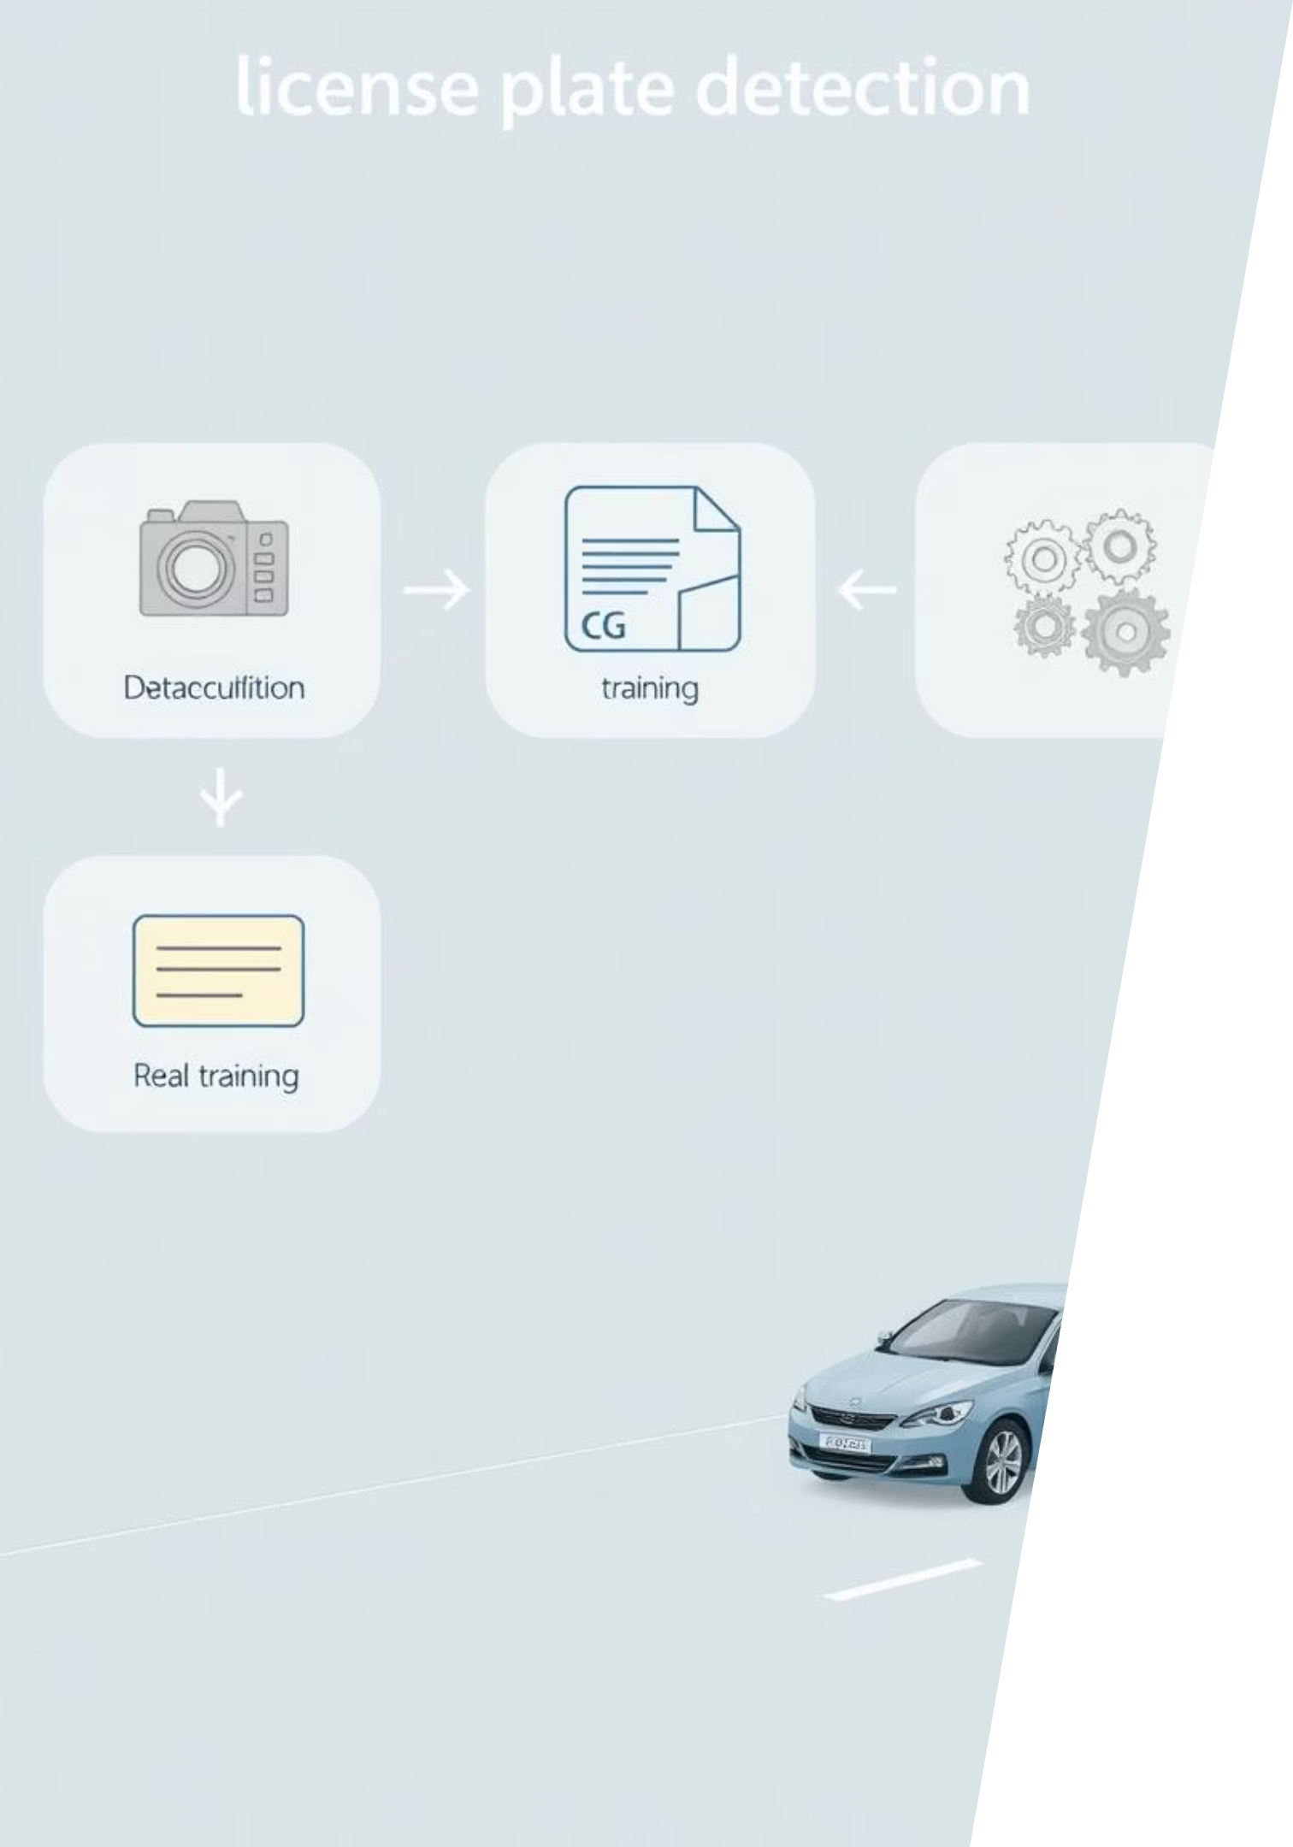



Methodology: Detection Pipeline
Dataset Download
Acquiring and preparing the labeled image dataset.
YOLOv8 Training
Fine-tuning the YOLOv8 model with our specific dataset.
Evaluation on Video
Assessing real-time detection performance on video streams.

Slide 6
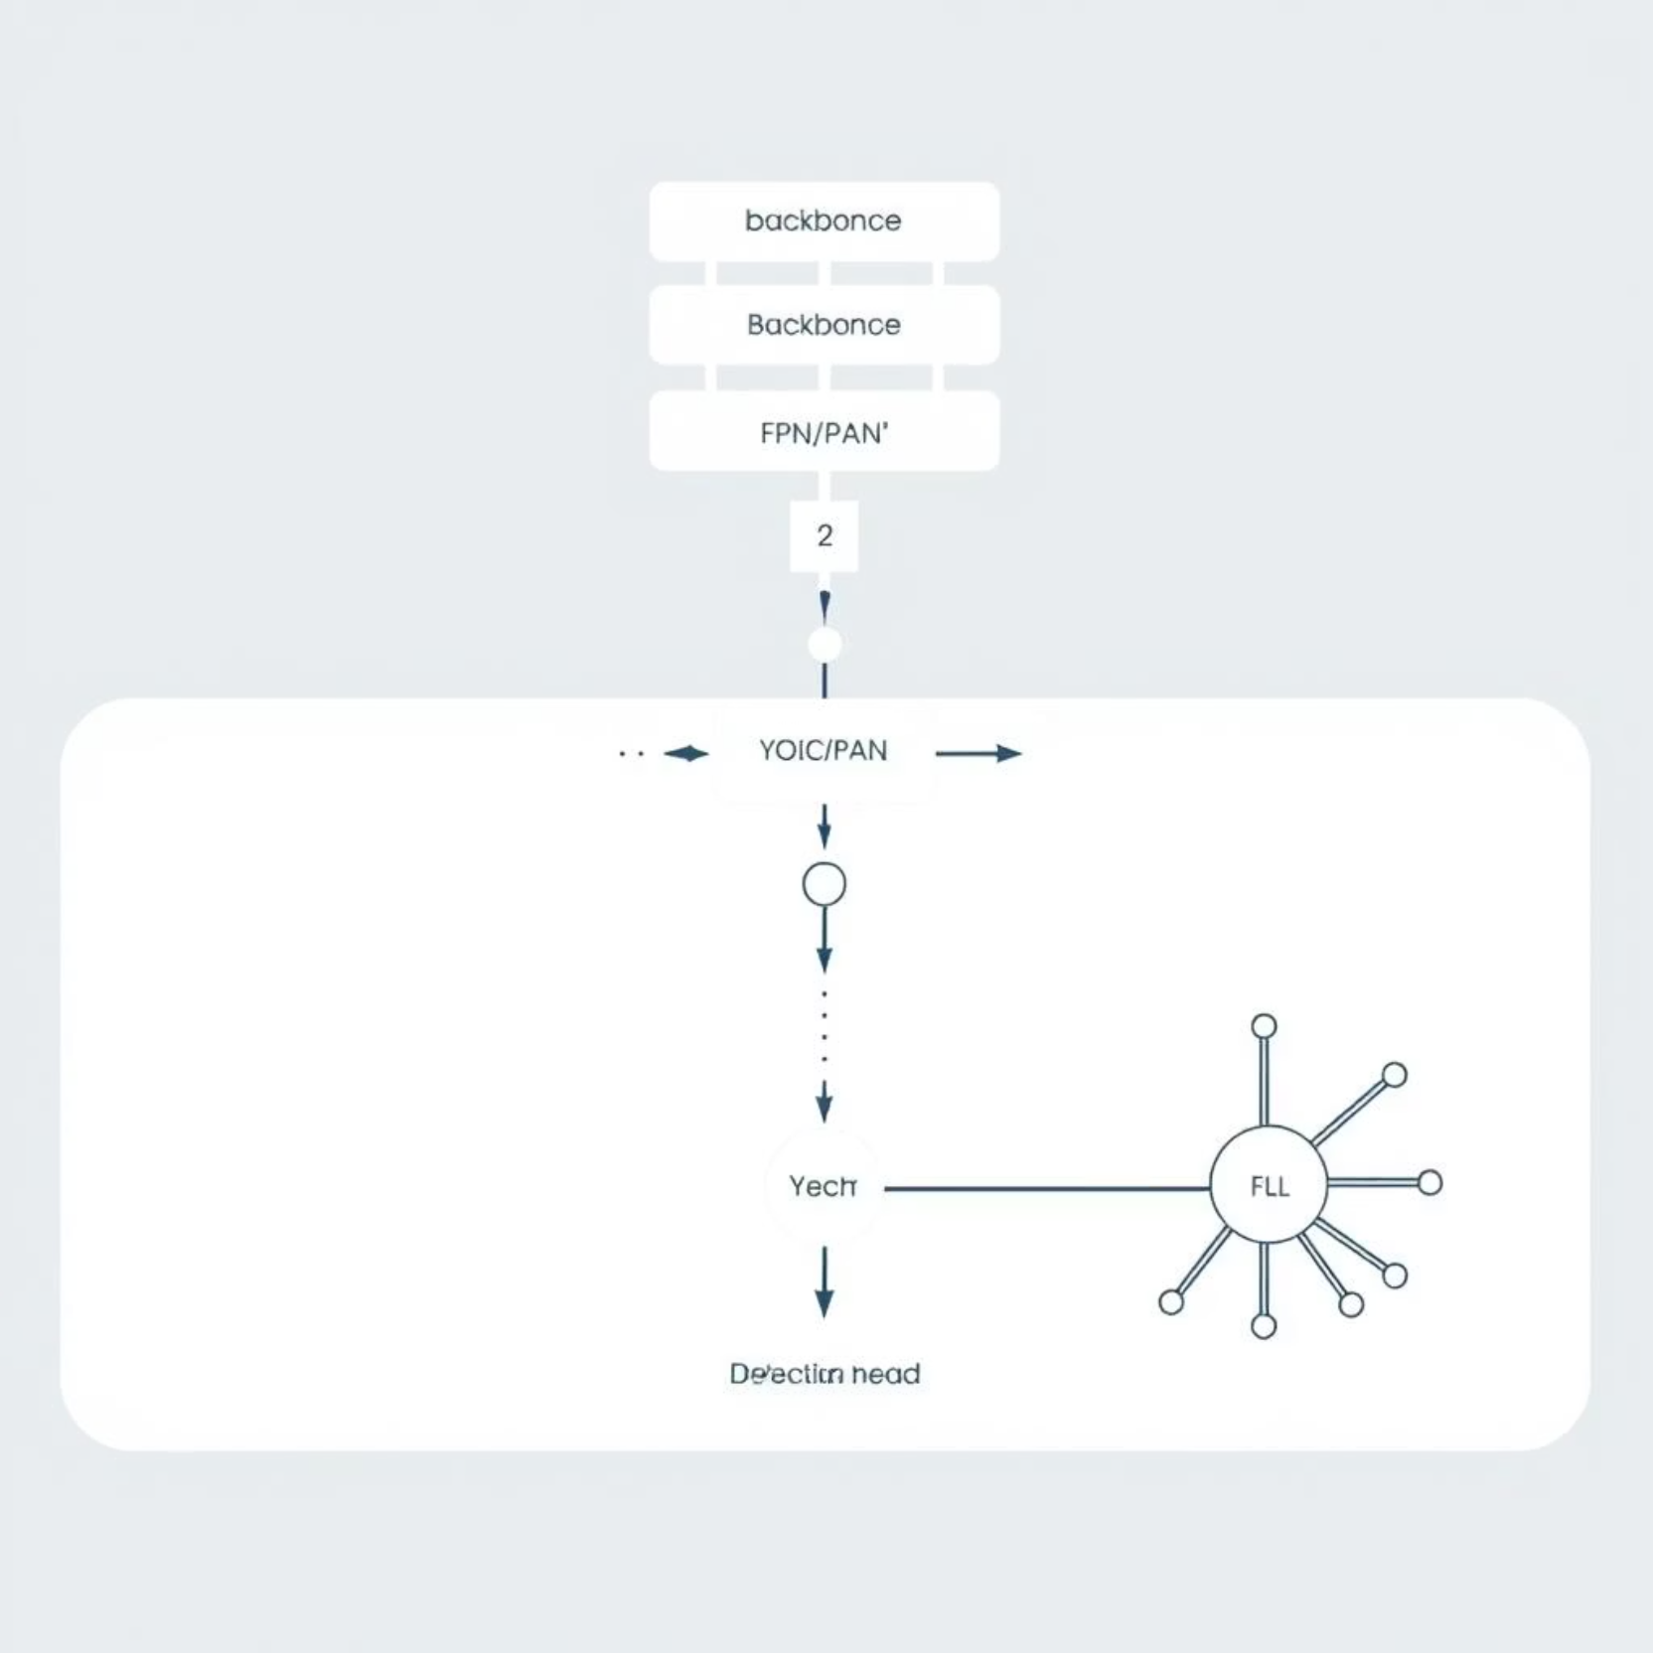
YOLOv8 Deep Architecture
YOLOv8 utilizes a sophisticated deep learning architecture designed for efficient and accurate object detection.
Backbone
Extracts essential features from input images.
Neck
Connects backbone to head, enhances feature fusion through FPN and PAN.
Head
Generates final detection outputs: bounding boxes and class probabilities.

Slide 7

Model Tuning Parameters
Optimal parameter tuning is crucial for achieving high accuracy and efficient model performance.
0.01
100
Learning Rate
Epochs
Initial rate for gradient descent.
Number of complete passes through the training dataset.
640x640
16
Image Size
Batch Size
Input resolution for the model.
Images processed simultaneously per iteration.
—
Optimizer
Adam, for efficient convergence.

Slide 8
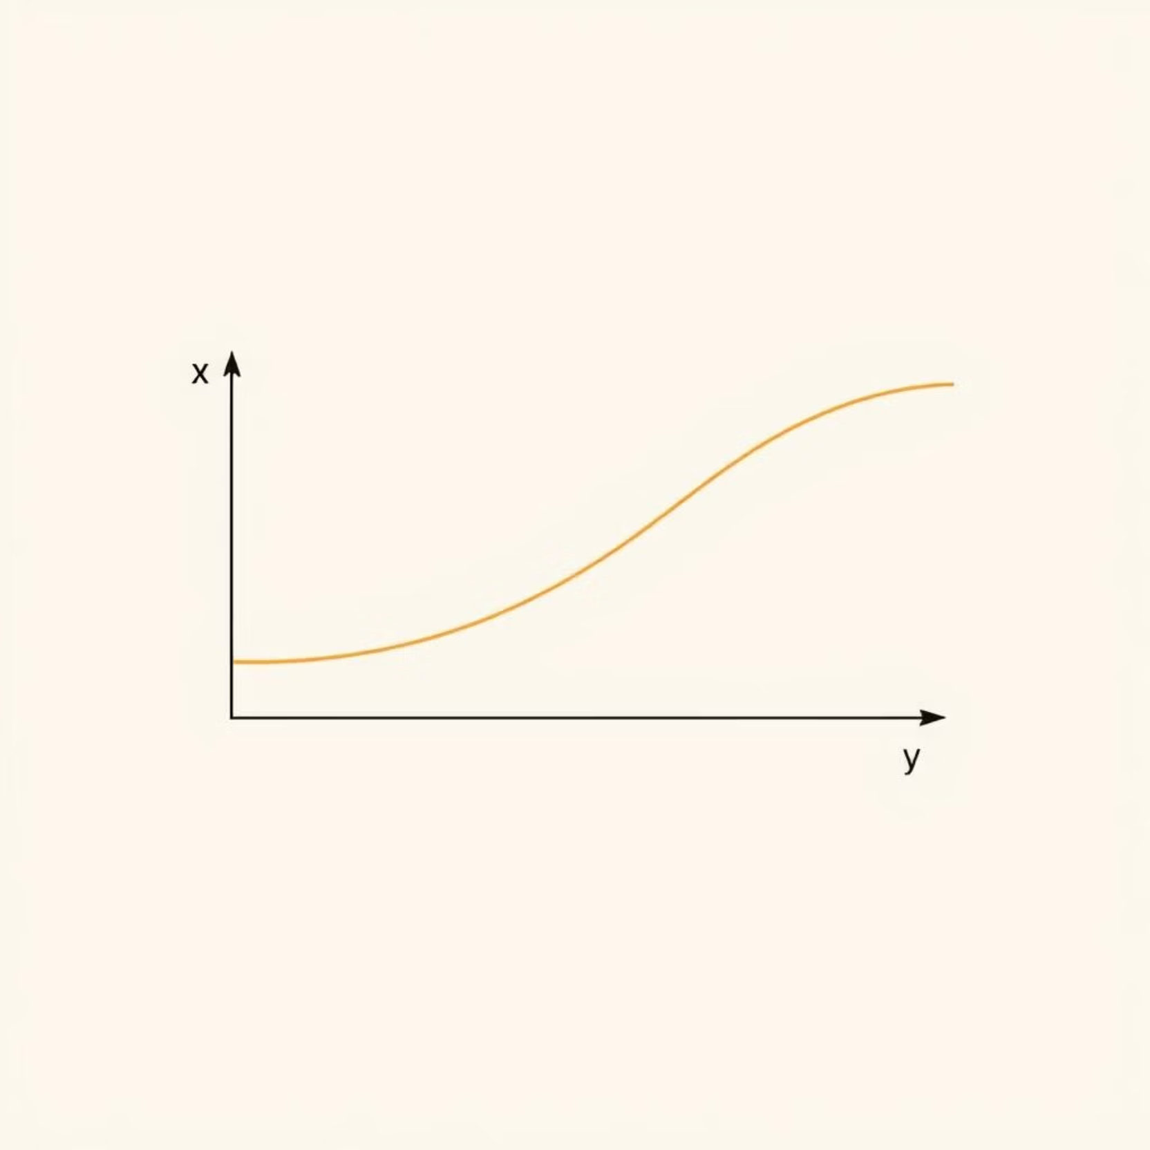
Activation Function
YOLOv8 leverages the activation function to introduce non-linearity, mitigating the vanishing gradient problem.
Equation: f(x) = x for x > 0, and f(x) = ax for x <= 0
Where 'a' is a small positive constant (e.g., 0.01), allowing a small gradient when the unit is not active.

Slide 9



Error Minimization: Loss Functions
The model's performance is optimized by minimizing a composite loss function, ensuring accurate predictions across multiple facets.
Objectness Loss
1
Confidence of object presence.
Classification Loss
2
Correct class prediction.
Bounding Box Regression Loss
3
Accurate localization.
The Adam optimizer was employed, adapting learning rates for efficient convergence during training.

Slide 10
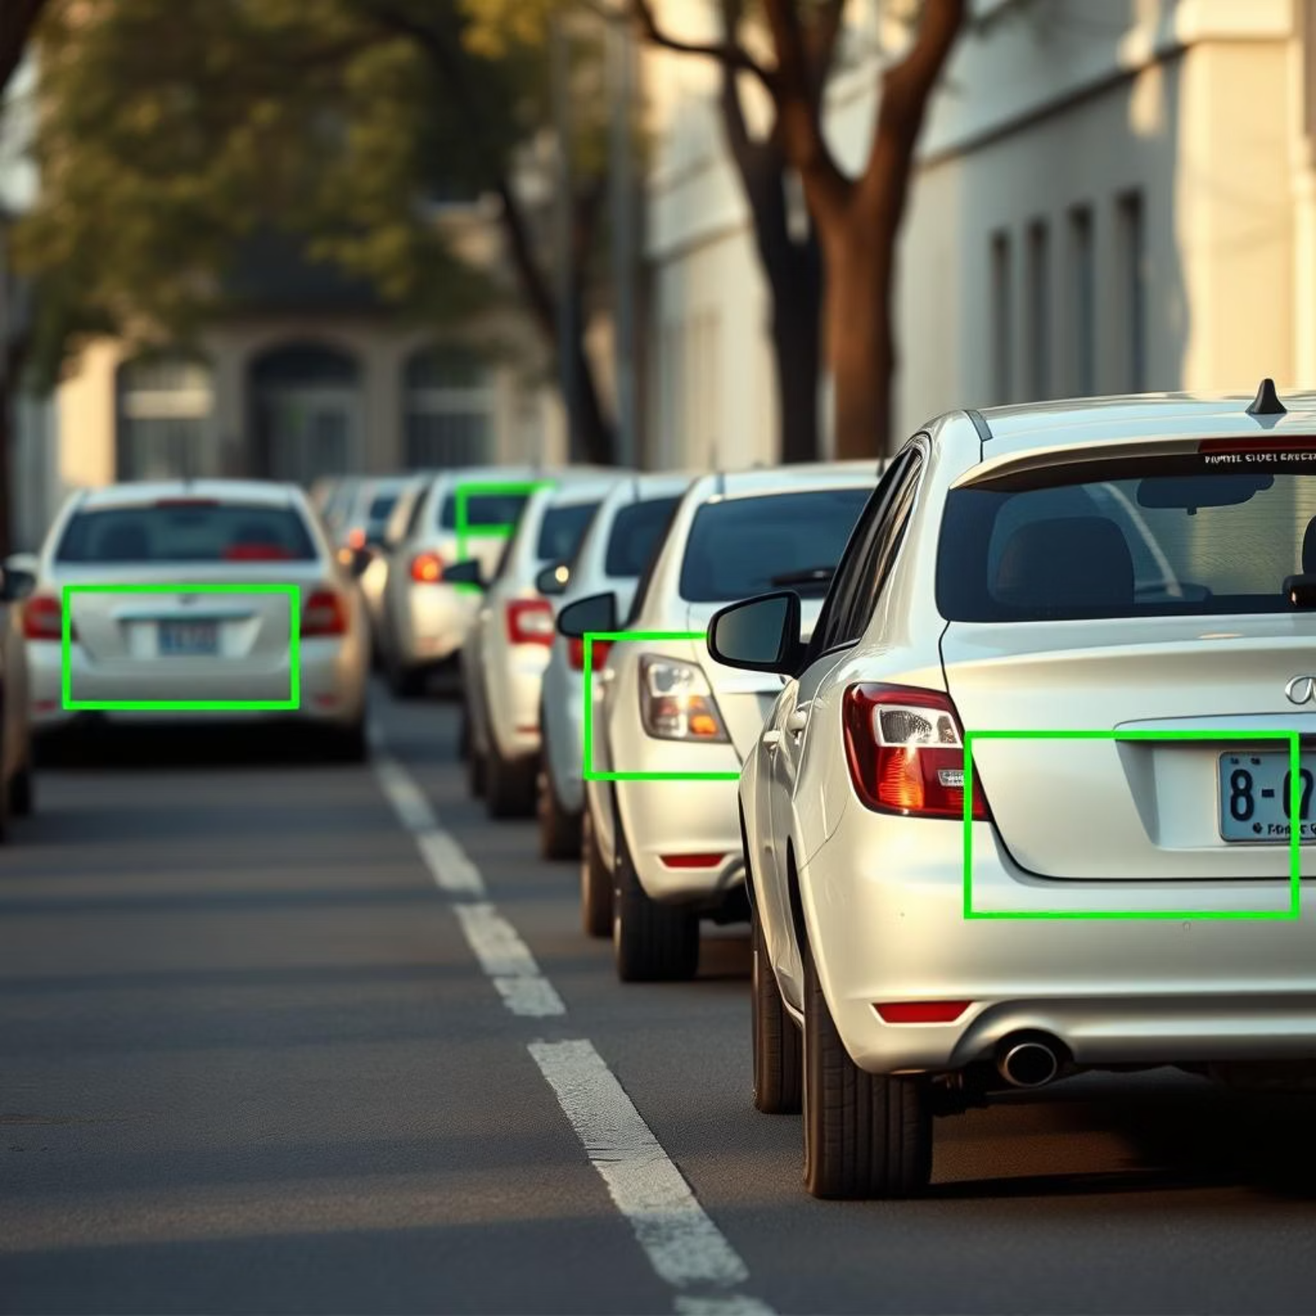
Detection Results: Real-time Performance
Example Output
Demonstrates effective detection in various scenarios.
Bounding Boxes
Precise localization of license plates.
Confidence Threshold
Set at 0.25 to filter detections.
The model shows robust performance, accurately identifying license plates even in challenging conditions.

Slide 11
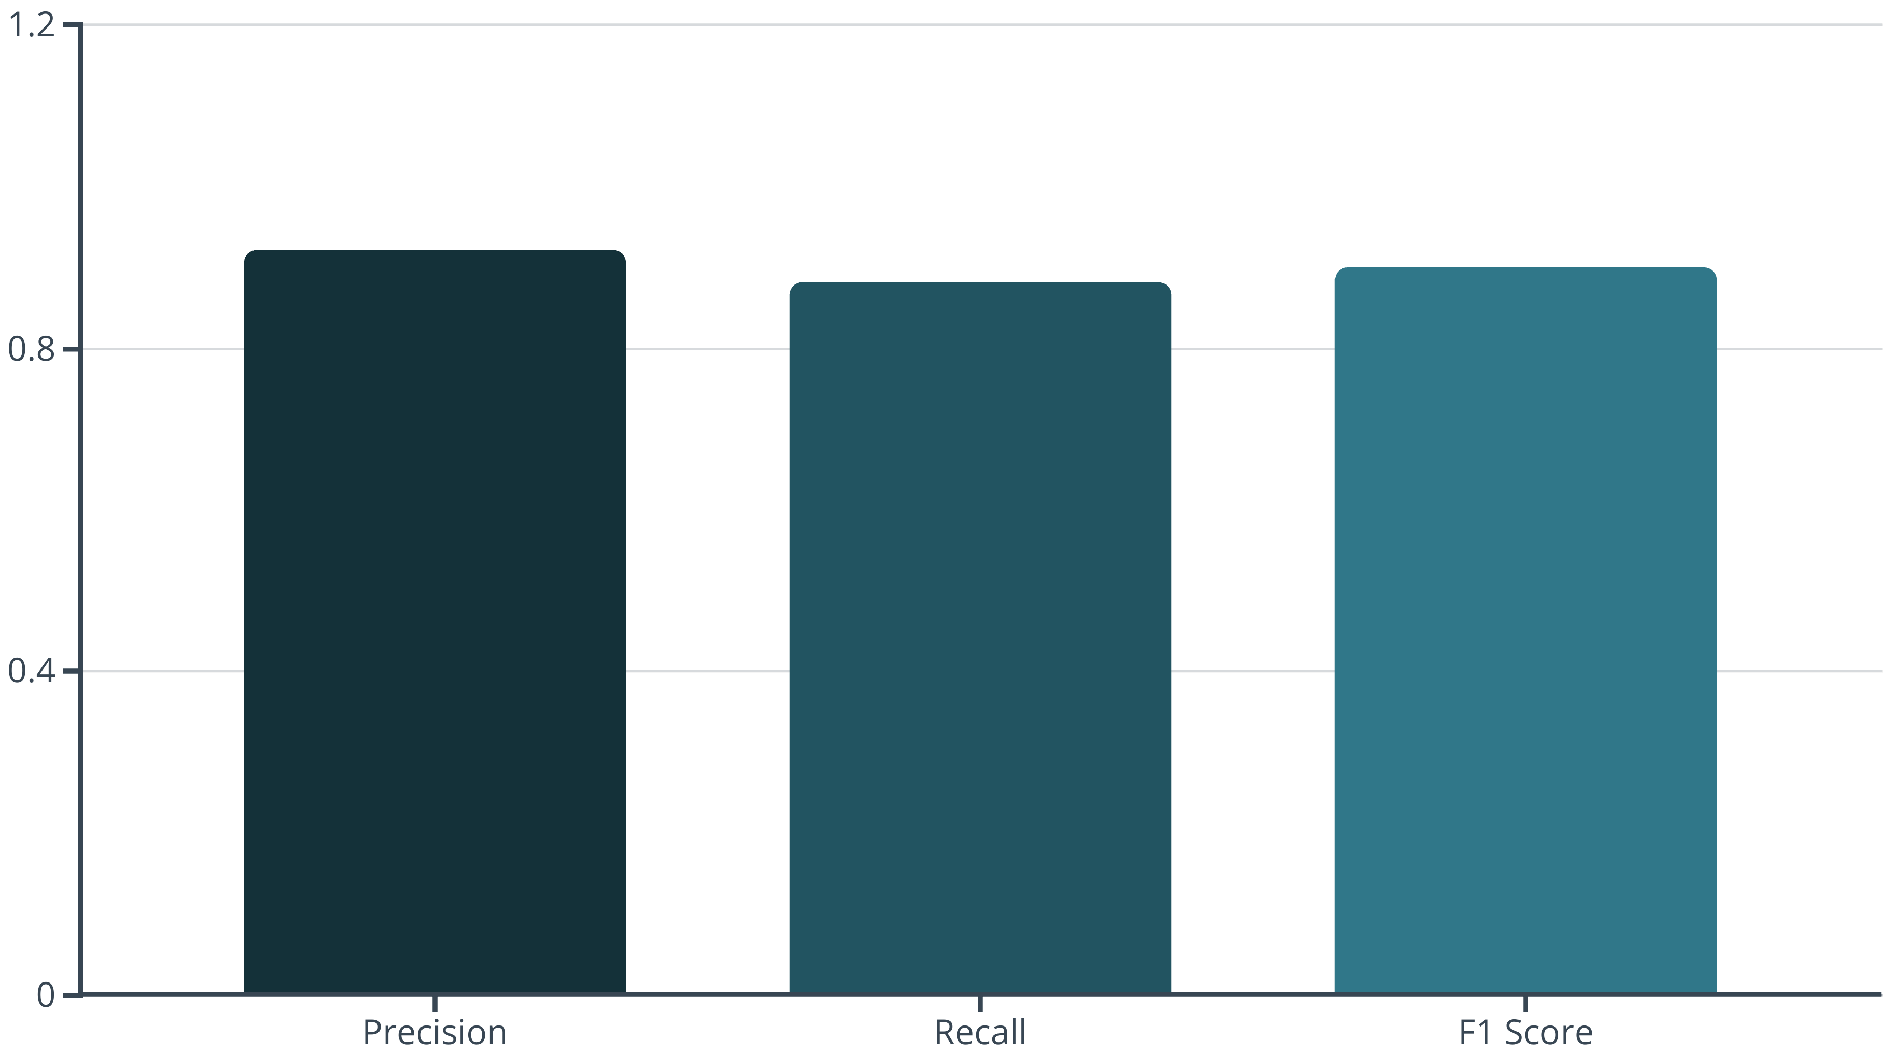
Model Evaluation & Performance
To validate the YOLOv8 model's effectiveness, a rigorous evaluation process was conducted, focusing on key performance metrics derived from the confusion matrix.
True Positives (TP)
False Positives (FP)
False Negatives (FN)
Correctly identified license plates.
Objects incorrectly classified as license plates.
Actual license plates that the model failed to detect.
The final evaluation metrics demonstrate the model's robust performance in accurately detecting license plates.
Metric
Value (Validation)
Precision
0.92
Recall
0.88
mAP50
0.90
The F1 Score provides a harmonic mean of precision and recall, offering a balanced measure of the model's accuracy.
Calculated F1 Score from the final epoch: 0.90.

Slide 12
Project Conclusion: Achievements & Future Vision
Project Achievements
Future Directions
Robust real-time detection with YOLOv8.
Real-time production deployment.
Precise license plate localization.
Integrated Optical Character Recognition (OCR).
High confidence in object presence.
Optimization for edge devices.
Efficient model performance.
Expanded recognition for diverse conditions.

Slide 13
References and Tools
Dataset: Roboflow Public License Plate Dataset
Model Framework: Ultralytics YOLOv8 GitHub Repository
Foundational Paper: "You Only Look Once: Unified, Real-Time Object Detection"
Key Libraries: Ultralytics, PyTorch, Pandas, NumPy, OpenCV, Matplotlib

Slide 14
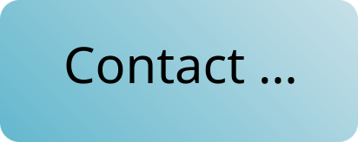
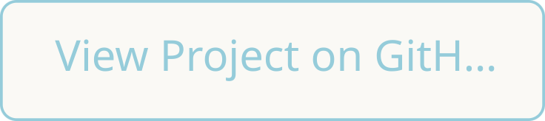
Thank You for Your Attention
We appreciate your time and interest in our License Plate Detection project using YOLOv8. We are open to any questions you may have.

